Slide 1
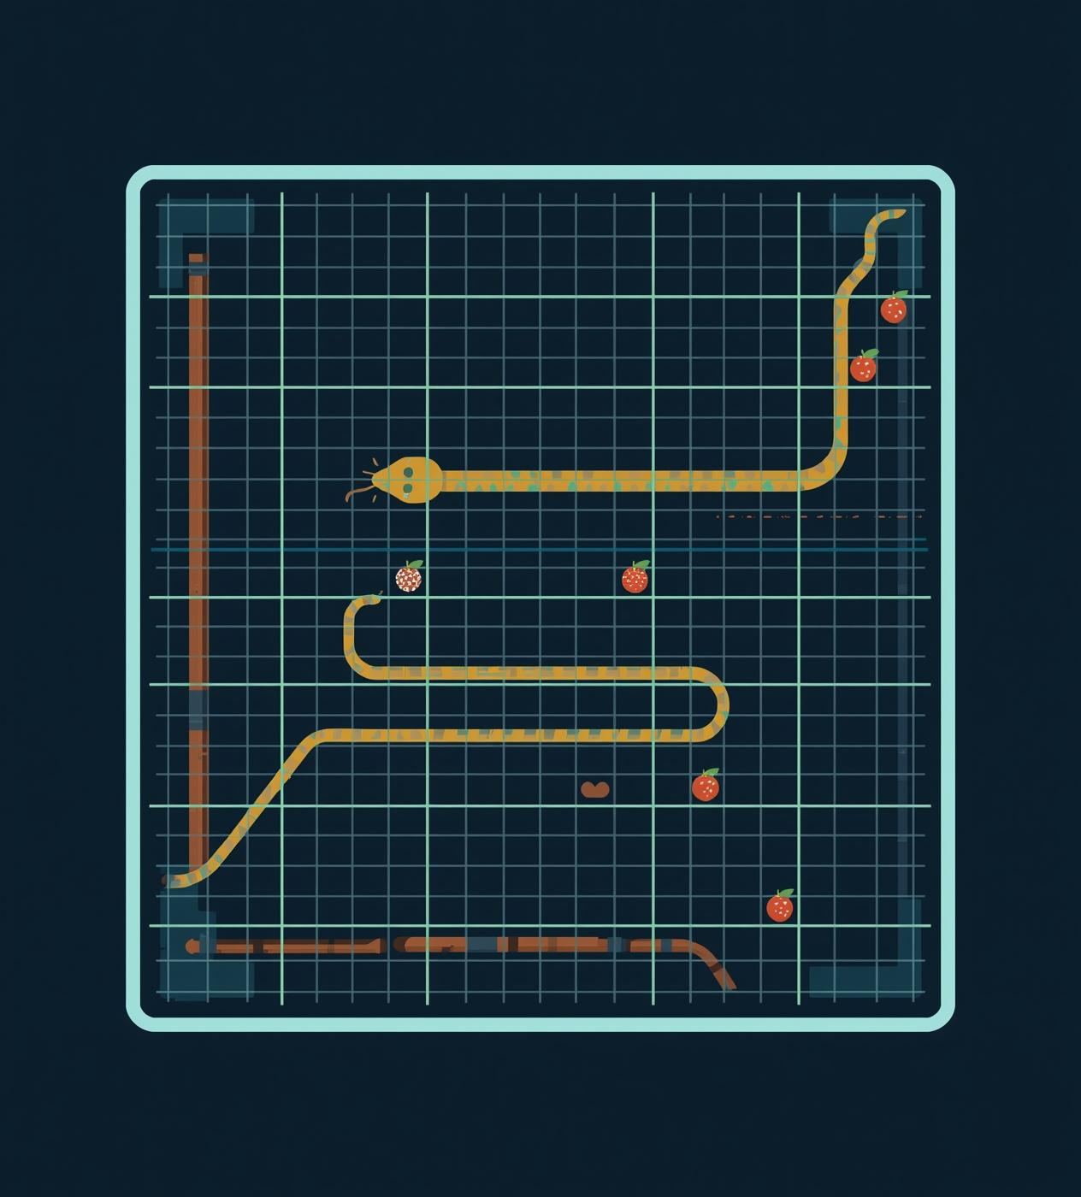
DSCI-6612-01
Intro to Artificial Intelligence
Comparison of
Search-Based and Reinforcement Learning Agents in Solving the Game of Snake
Professor : Vahid Behzadan
Team Members
Bharadwaj Gottimukkula
Dinesh Reddy Kunduru

Slide 2

Project Objective
The objective of this project is to design and evaluate two intelligent Snake-playing agents using Search-Based techniques and Reinforcement Learning.
We aim to examine how each agent navigates, makes decisions, adapts to changing game states, and survives in the environment.
.
The project focuses on comparing the performance, strengths, and limitations of classical path finding (BFS/A*) against modern learning-based methods (DQN).
Our goal is to determine which approach is more effective for real-time decision-making in dynamic environments.

Slide 3
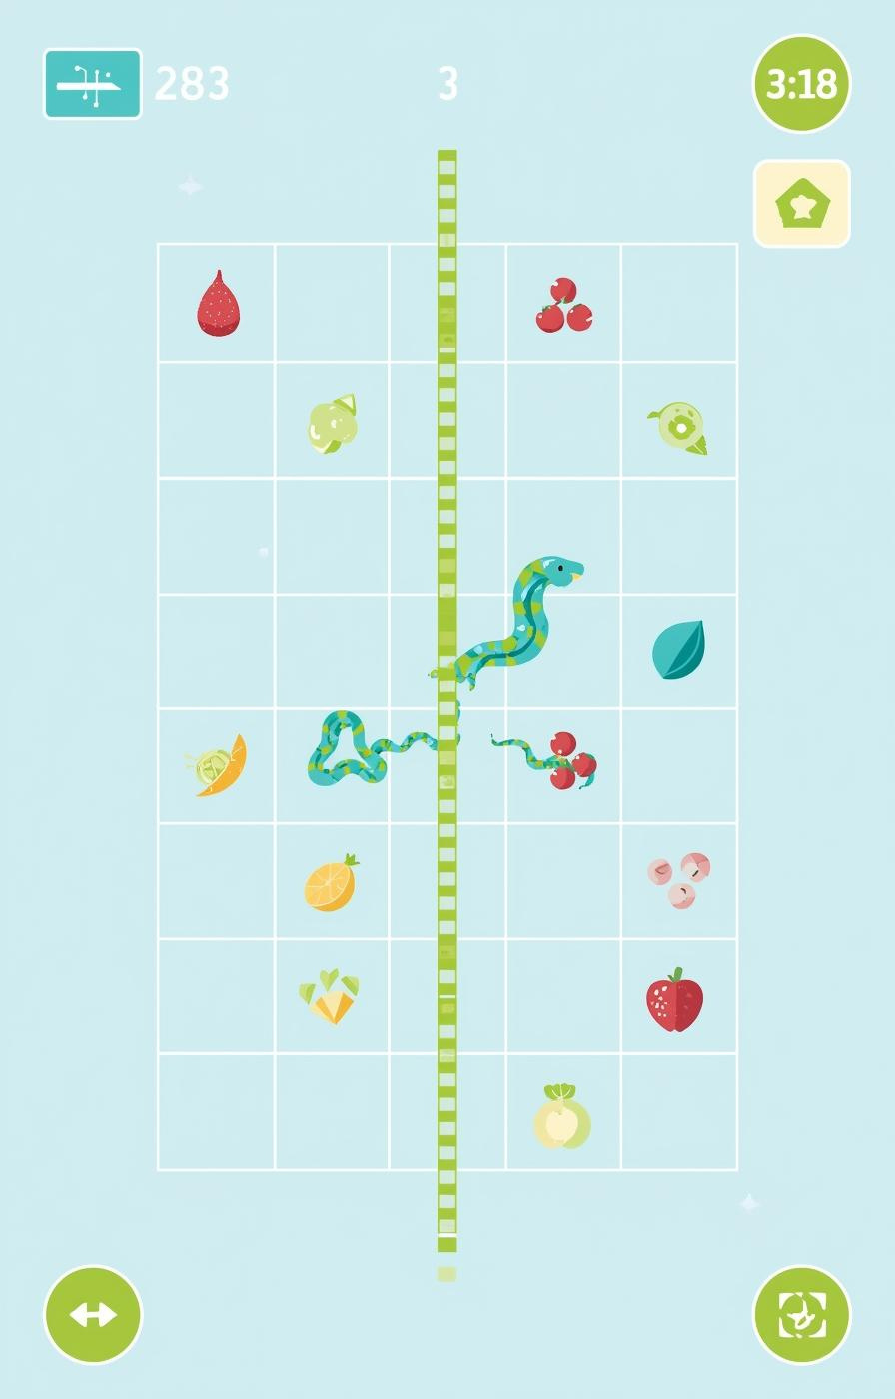
Approach
We developed a unified Snake game environment to ensure fair evaluation between both agents.
The Search-Based agent uses BFS and A* algorithms to compute optimal or safe paths toward the food.
The Reinforcement Learning agent is built using a Deep Q-Network that learns gameplay behavior through repeated interactions and reward feedback.
Both agents were tested under identical conditions to compare efficiency, adaptability, stability, and overall performance.

Slide 4
Deliverables
Comprehensive Project Documentation
  Detailed explanation of the Snake game environment and the design of both Search-Based and Reinforcement Learning (DQN) agents.
2. Algorithm Development
  Fully implemented Search-Based algorithms (BFS, A*, safe-path logic) and Reinforcement Learning models using Python.
3. GitHub Repository
  Complete access to all project files including source code, models, documentation, and assets.
4. Project Presentation & Showcase
  Final PowerPoint summarizing objectives, methodology, agent designs, performance results, and conclusions.

Slide 5
Search-Based Agent
BFS (Breadth-First Search) - Shortest Path to Food
BFS is used to compute the shortest possible path from the snake’s head to the food by exploring the grid level-by-level.
The algorithm ensures that if a path exists, BFS will always find the most optimal one in terms of number of moves.
BFS treats every move (up, down, left, right) as having equal cost, making it ideal for uniform grid-based movement
In the project, BFS is used for:
  Finding direct, optimal routes to food
  Checking whether safe paths exist in the current grid
  Quickly evaluating reachable and unreachable areas

Slide 6
Search-Based Agent
A* Search - Faster and Efficient Pathfinding
A* combines the actual path cost (g) with a heuristic estimate (h) to prioritise moves, allowing it to find optimal paths more efficiently than BFS.
The algorithm uses the Manhattan distance heuristic, which fits perfectly with Snake’s grid-based movement and helps guide the search toward the food.
A* expands far fewer nodes than BFS, making it faster and more efficient, especially when the snake grows and the grid becomes more complex.
It dynamically considers obstacles such as snake body segments and walls, recalculating optimal paths as the environment changes each step.
While highly efficient, A* may still lead the snake into dead-ends, so the project integrates safe-path simulation and tail-following strategies to avoid unsafe paths.
A* is used when:
  Faster search time is required.
  Multiple potential paths exist and need prioritization
  The agent must efficiently navigate around obstacles (walls & snake body)

Slide 7
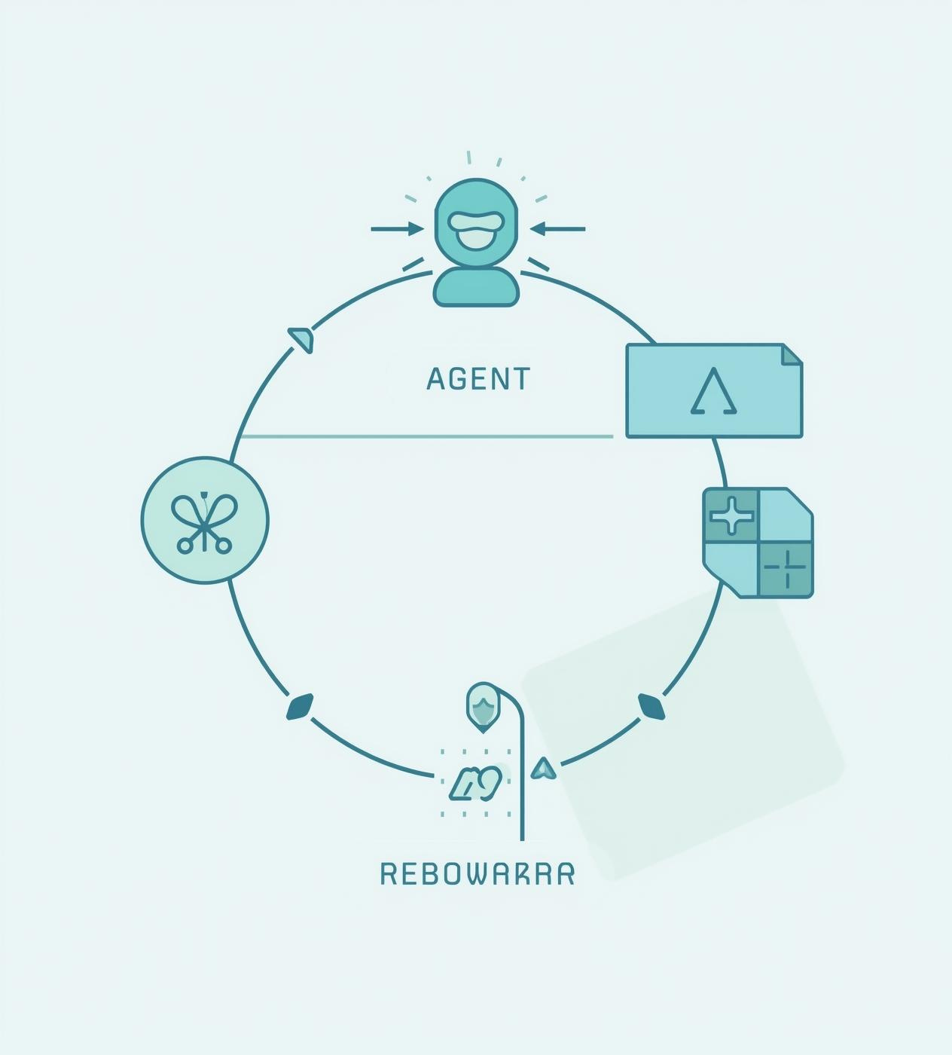
Reinforcement Learning
The DQN agent learns to play Snake by interacting with the environment and receiving rewards based on its actions.
A neural network predicts Q-values for each possible move, allowing the agent to choose the action that maximizes future rewards.
The agent receives positive rewards for eating food, negative rewards for dying, and small rewards for surviving each step.
Over time, the agent learns long-term survival behaviors, avoids dangerous patterns, and discovers strategies without explicit programming.
While training requires time and computational effort, the RL agent becomes highly adaptable and capable of handling complex game scenarios

Slide 8
Search-Based Pathfinding Workflow
The agent reads the current game state, including the snake’s head position, body segments, walls, and food location, to understand the grid layout before planning the next move.
It constructs a graph from all free cells, treating each available cell as a node and connecting it to its valid neighboring cells based on possible movements.
The agent applies BFS or A* to compute the shortest or safest path to the food, where BFS explores level-by-level and A* uses the Manhattan heuristic to prioritize promising directions.
The computed path is simulated step-by-step to verify that following this route will not trap the snake or block access to its tail after eating the food.
If the path is unsafe, the agent switches to survival strategies, such as tail-following or choosing longer paths, before finally executing the next move based on the safest available option.

Slide 9
Reinforcement Learning Agent Workflow
The agent converts the current game state into a numerical feature vector, capturing information such as danger directions, snake direction, and food location relative to the snake’s head.
This state vector is passed through the neural network, which outputs Q-values representing the expected reward for each of the four possible actions (up, down, left, right).
The agent selects an action using an ε-greedy policy, meaning it either chooses a random action to explore or picks the action with the highest predicted Q-value to exploit learned knowledge.
After executing the action, the agent receives a reward, observes the next state, and stores this experience (state, action, reward, next state) in replay memory for future training.
The agent updates its neural network through Q-learning, using sampled experiences from memory to minimize the loss and improve decision-making over thousands of iterations.

Slide 10
Comparison Table
Aspect | Search-Based Agent (BFS / A*) | Reinforcement Learning Agent (DQN)
Decision Strategy | Rule-based, deterministic | Learns from experience, adaptive
Path Quality | Optimal shortest paths, not always safe | Sometimes longer paths, but safer over time
Adaptability | Low – struggles in unseen situations | High – improves behavior through training
Performance Over Time | Consistent but limited | Starts weak, improves significantly with training
Handling Tight Spaces | Weak – prone to self-traps | Strong – learns survival patterns
Computation | Light, instant decisions | Heavy – neural network + training
Predictability | Highly predictable | Less predictable, dynamic
Strength | Optimal pathfinding | Long-term survival & strategy
Limitation | Poor in congested grids | Requires extensive training

Slide 11
Conclusion
Search-Based Agent
Strengths:
Produces deterministic and predictable behavior based on optimal pathfinding.
Does not require training, making it simple and efficient to deploy.
Ensures shortest paths in open environments.
Limitations:
Unable to adapt to unfamiliar or complex situations.
Easily trapped when the snake occupies a large portion of the grid.
Depends heavily on hand-crafted rules.
Reinforcement Learning Agent (DQN)
Strengths:
Learns advanced survival strategies through repeated gameplay experience.
Adapts to dynamic and complex environments more effectively than rule-based methods.
Capable of achieving higher long-term performance with sufficient training.
Limitations:
Requires significant training time and computational resources.
Performance is sensitive to reward design, hyperparameters, and exploration strategy.
Behavior may be unpredictable during early training stages.

Slide 12


